Slide 1

Welcome to Data
Analysis of survery in covid

Slide 2
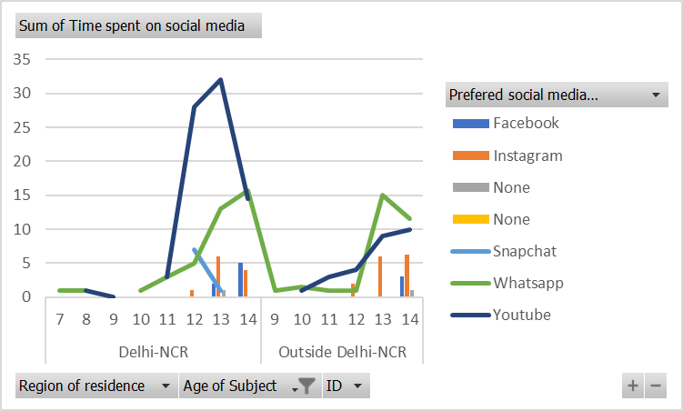
Age group 7-14
Delhi –NCR
1)People with this age group connected more with Youtube then Whatsapp
Outside Delhi-NCR
1)People with this age group connected more with Whatsapp then youtube

Slide 3
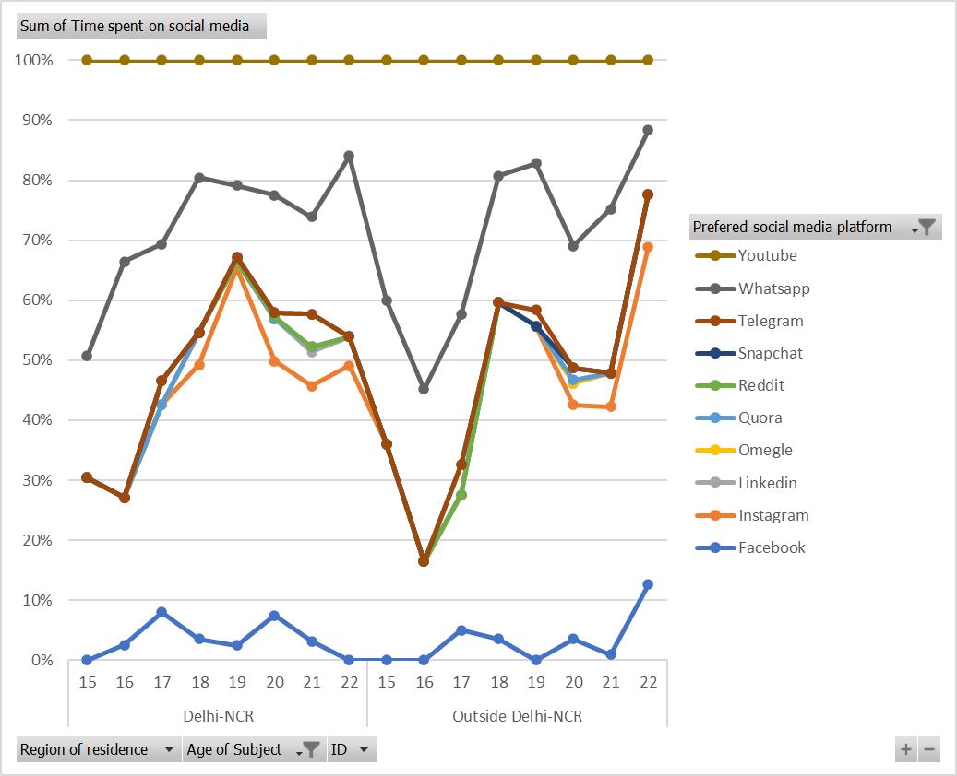
Age group 15-22
Delhi-NCR
People are more connected to whatsapp then youtube
Outside Dlehi-NCR
People are more connected to whatsapp then youtube

Slide 4
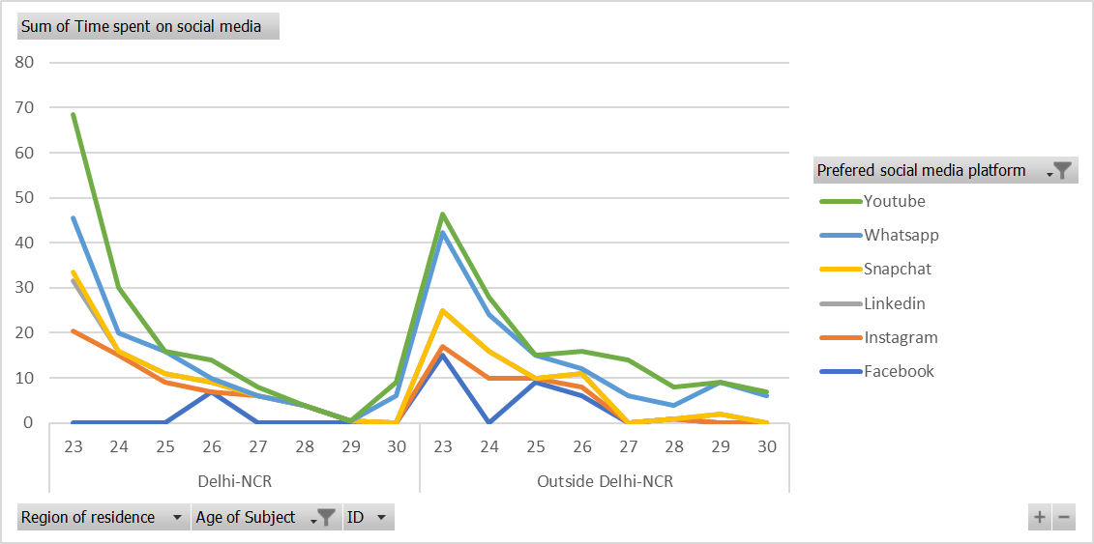
Age group 23-30
Delhi-NCR
People are more connected with youtube but usage of social media gone decreasing
Outside Delhi – NCR
People are more connected with youtube but useage of social media gone decreasing

Slide 5
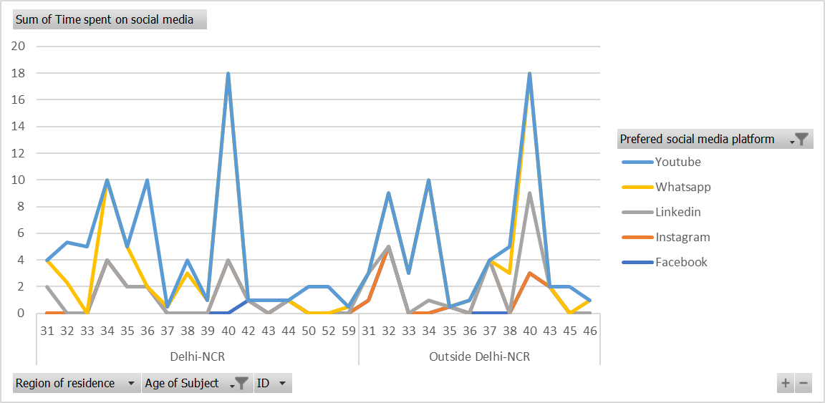
Age Group 31-59
Delhi –NCR & Outside Delhi -NCR
People with this age group are more connected with youtube

Slide 6
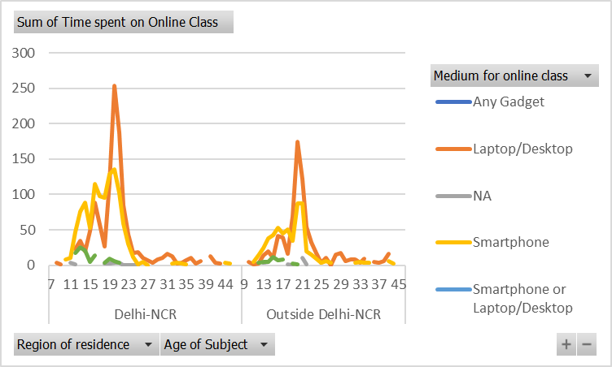
Working together in real time
People from Delhi -NCR and Outside Delhi -NCR people use laptop/desktop more for online education .
Smartphone is being used by more young people between age of 7-23

Slide 7
Some insights
People with young age spend more time on laptop/desktop then smartphones.
Youtube and Whatsapp are more used
People with age group of 31-40 we can see linkedin is much more consistently used this people spend less time on education and spend more time on youtube they are viewers
Instagram can perform well with whatsapp also

Slide 8
Any suggestions

